Slide 1
GLOBAL SUICIDE RATES BETWEEN 1995-2015.
Week 5 group project

Slide 2
Group 2 : Team Analysts
Team Members
Simon Waweru - Group Leader.
Laura Wangari -
Gabriel Abura -
Derrick Kuria -

Slide 3
Problem Statement
According to WHO, 800 000 people die due to suicide every year, which is one person every 40 seconds.
For each adult who died by suicide, there’s a possibility of 20 others attempting suicide.
Therefore, we obtain an overview of the distribution of suicide rates in the world and the effects of economic aspects on suicide rates.

Slide 4
Project Objectives.
To show how the economic aspects such as GDP affect the rates of suicide.
To obtain an overview of suicide rates over a specific period of time.
To show distribution of suicide cases across the countries included in our data.

Slide 5
Project Data Resources
We sourced our data from kaggle and some information about Suicides from WHO.

Slide 6
Research Question.
The research question questions will help us achieve our objectives, the following are our research questions;
Do economic aspects(GDP,per_capita income) affect the rate of suicide?
Is population direct proportion to number of suicides?
What is the trend of suicides yearly between 1995 to 2015?
What is the suicide rate by gender and age group?
The correlation of different economic aspects and suicide rates

Slide 7
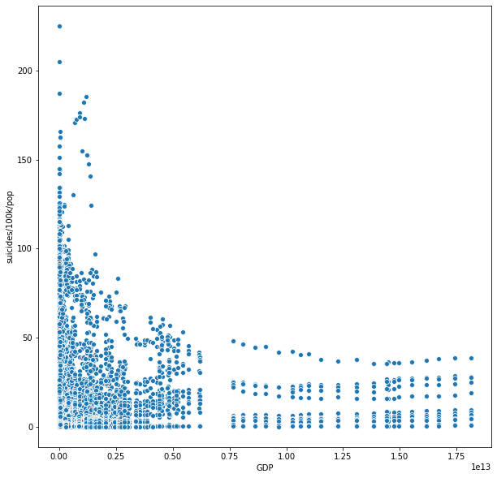

DISTRIBUTION OF SUICIDES BY ECONOMIC FACTORS
A
Our analysis has been able to get us some insights from our data sets and we have been able to plot them using different types of graphs in order for us to visualize the results.
The first insight was the number of suicides depending on the country’s economic factors, We used GDP as our measure of economic aspect. The graph below shows that it's more likely for someone in a country with a lower GDP to commit suicide this might be driven by issues such as lack of employment, poverty and eve diseases just to name a few.

Slide 8
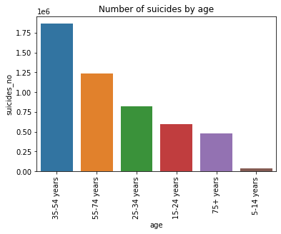

DISTRIBUTION OF SUICIDE BY AGE
Our second Insight is the distribution of suicides by Age. Here from our analysis we see that the age group with most suicides is 35-54 year. People between this age group are more likely to be facing mental health issues because they face pressure from society and also they are most likely to face unemployment because they are part of a country’s work force unlike their counterparts of old age who might be retired and the young ones still in school

Slide 9
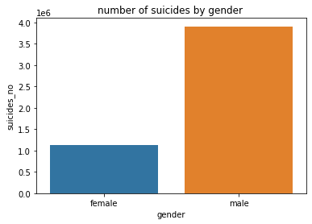

Number of suicides by gender
On this insight we find out males are almost 3 times more likely to commit suicide than their female counterparts. Below might be some of the reasons why
Men are more impulsive than women
Alcohol and substance abuse is more common in men in most countries
Women are less likely to shoot themselves on the head (fastest way to commit the act)
Being bullied at school, work or college
Mental illness such as depression

Slide 10
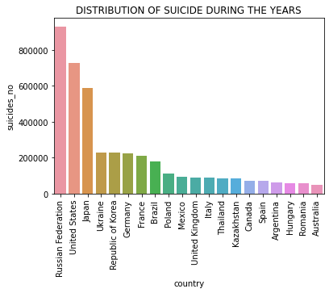
Suicides by Country
This insight contradicts with our first insight that says countries with more GDP are likely to have less suicides because the correlation between population and suicide is far greater than correlation between economic factors(GDP) and suicide. Take Russia for example in our dataset it has the highest suicide rate through the 30 years because of its large population yet it has a higher GDP than most of the other countries

Slide 11
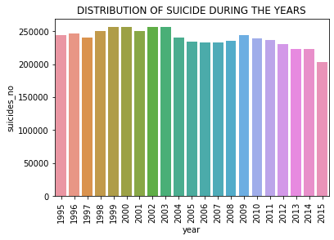

Distribution of suicides through the years
Between 1995 and 2015 the suicidal rates have been quite similar but the rates were highest in 1999 and lowest in 2015. Surprisingly suicidal rates have also been reducing in the 2000’s compared to the 90’s while we expect otherwise because of depression from the age of technology.

Slide 12

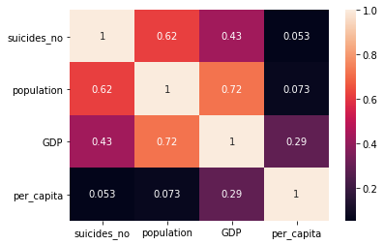
Correlation between our factors
This insight was just to see how all our factors correlate to each other in order to know the most influential factor of our dataset . As mentioned before we see that population has the greatest correlation to suicide numbers compared to all other factors . This simply means the higher the population the higher the rate of suicides and this influences suicides more than any other factor eg GDP (for this dataset only)

Slide 13
Recommendations
Population : Government offering essential services and providing employment for its citizens
Gender : Sensitize men on importance of Mental health
Strict gun laws
Community sensitization in areas that have faced war, trauma and abuse as such people are more likely to commit suicide hence counselling should be encouraged to manage PTSD cases.

Slide 14
Questions??

Slide 15
THANK YOU!!!

